Slide 1
Mobile controlled home lights on/off with intensity control
J. KAMESH
K.V.S.P AKHILESH
K.KEERTHANA
K.JAYASRI
V.BHARAT
M.GAYATRI
N.JAHNAVI
17L31A1244
18L31A1201
18L31A1206
18L31A1207
18L31A1209
18L31A1226
18L31A1289
TEAM 1

Slide 2
INTRODUCTION
This project is a easy way of controlling home lights ON/OFF by operating from mobile itself.
It can decrease the work of humans so that they don’t need to walk and switch on/off lights.
From the place where they are sitting itself, they can operate from their mobile phones. If we are new to the room,
We often find it difficult to locate the switch. Most of the times,
Many of us forget to switch of the lights leaving the room in which we stay most of the time.
This results in unnecessary power wastage.
Therefore, a mobile control can turn on when the person enters and off when the person leaves the room.

Slide 3
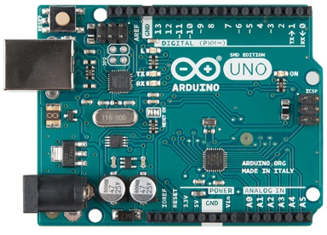
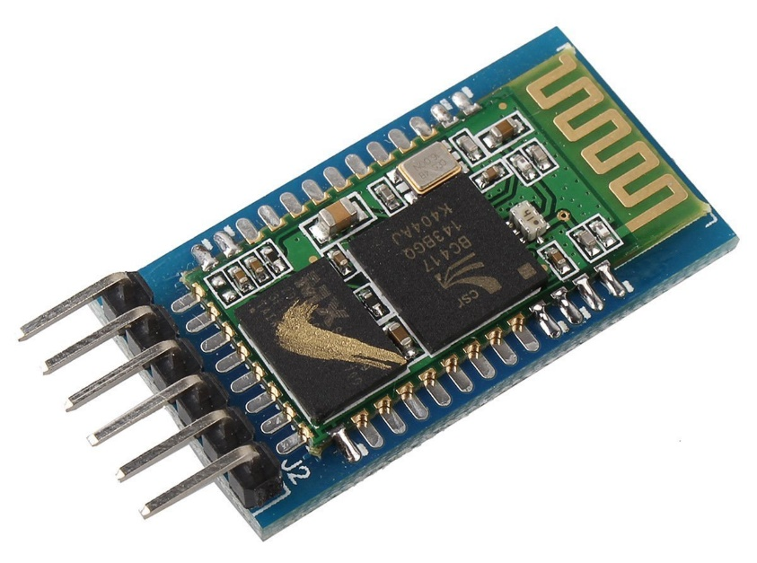
COMPONENTS
The ARDUINO UNO is a microcontroller board based on the ATmega328. It has 20 digital input/output pins (of which 6 can be used as PWM outputs and 6 can be used as analog inputs), a 16 MHz resonator, a USB connection, a power jack, an in-circuit system programming (ICSP) header, and a reset button.
HC-05 MODULE is an easy to use Bluetooth SPP (Serial Port Protocol) module, designed for transparent wireless serial connection setup. Serial port Bluetooth module is fully qualified Bluetooth V2.0+EDR (Enhanced Data Rate) 3Mbps Modulation with complete 2.4GHz radio transceiver and baseband.

Slide 4
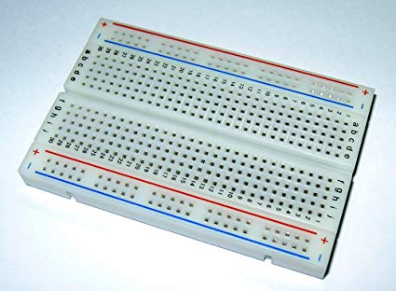
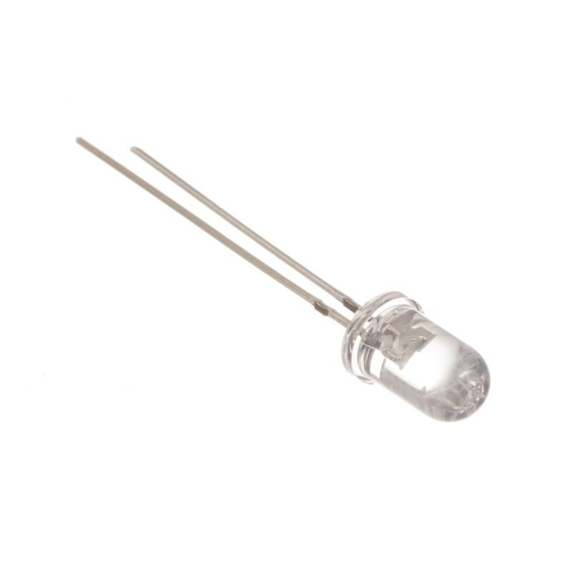
A BREADBOARD is a solderless device for temporary prototype with electronics and test circuit designs. Most electronic components in electronic circuits can be interconnected by inserting their leads or terminals into the holes and then making connections through wires where appropriate.
A light-emitting diode (LED) is a semiconductor light source that emits light when current flows through it. Electrons in the semiconductor recombine with electron holes, releasing energy in the form of photons.

Slide 5
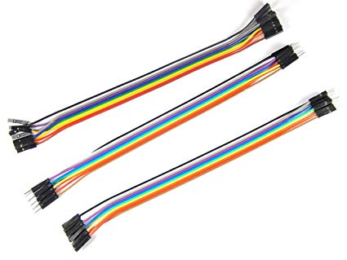
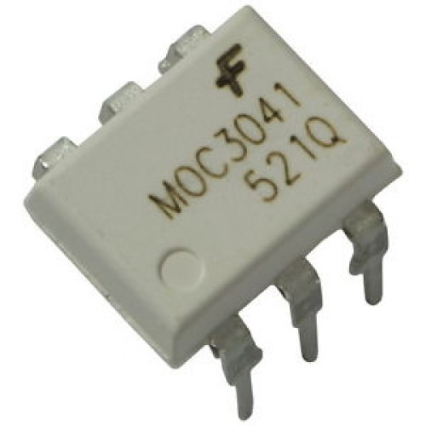
Jumper wires are simply wires that have connector pins at each end, allowing them to be used to connect two points to each other without soldering.Jumper wires are typically used with breadboards and other prototyping tools in order to make it easy to change a circuit as needed.
The MOC3041 device consist of gallium arsenide infrared emitting diodes optically coupled to a monolithic silicon detector performing the function of a Zero Voltage Crossing bilateral triac driver. Features: Simplifies Logic Control of 115 Vac Power.

Slide 6
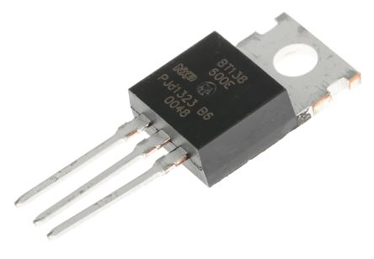
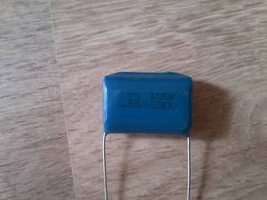
A capacitor is an electronic component used to store energy. ... Capacitors are measured in Farads as well as subdivisions of Farads such as uF(microfarad), nF (nanofarad), & pF (picofarad) and capacitors that are rated at 1 Farad or greater are typically referred to as Supercapacitors.

Slide 7
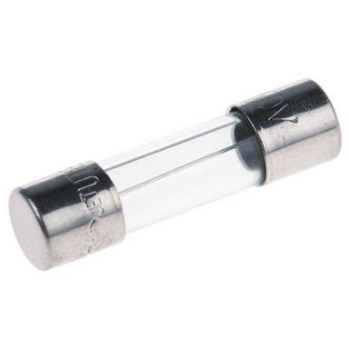
In electronics and electrical engineering, a fuse is an electrical safety device that operates to provide overcurrent protection of an electrical circuit. Its essential component is a metal wire or strip that melts when too much current flows through it, thereby interrupting the current. It is a sacrificial device; once a fuse has operated it is an open circuit, and it must be replaced or rewired, depending on type.

Slide 8
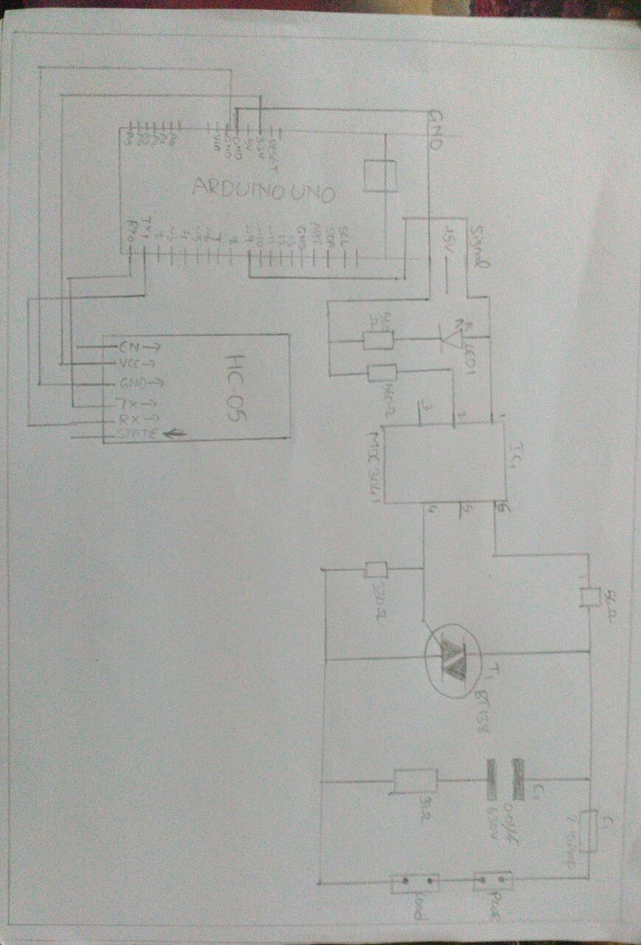
CIRCUIT FOR BOTH AC AND DC COMPONENTS

Slide 9
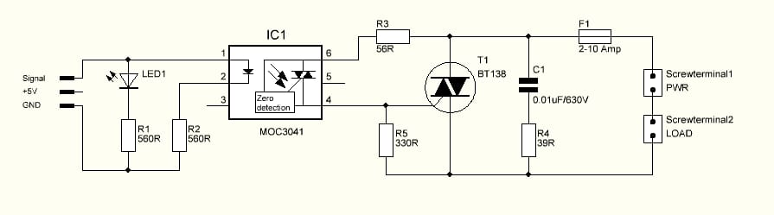
DIMMER CIRCUIT

Slide 10
int data;
void setup() {
pinMode(9,OUTPUT);
//digitalWrite(9,LOW);
Serial.begin(115200);
Serial.setTimeout(10);
}
void loop() {
if(Serial.available()>0){
data= Serial.parseInt();
Serial.println(data);
analogWrite(9,data);
}
}
S
O
U
R
C
E
C
O
D
E

Slide 11
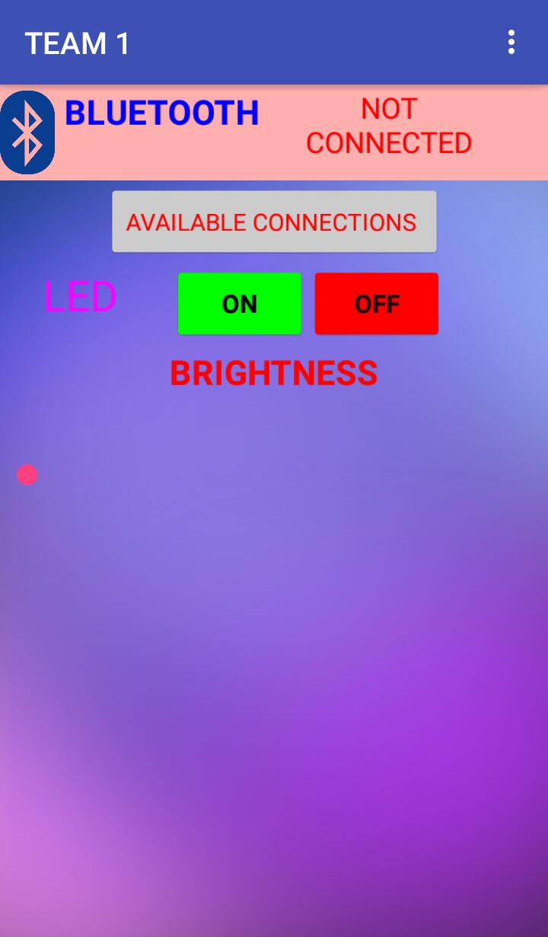
APP

Slide 12
DAY TO DAY APPLICATIONS
Control multiple lights simultaneously from a single button with powerful sense.
Monitor electricity usage, configure alerts when appliances turn on or turn off.
Connect your thermostat to the internet and you can remotely adjust the temperature from your smart phone.
Add sunrise and sunset times to your hard art and landscape tighting.
Save energy with some of your home’s biggest energy users by schedule and controlling larger 220V appliances

Slide 13


